Slide 1
RAP Validation
Where did it all go so wrong?
Coffee & Coding
Notes:
Hello
I’m sure many of you are hearing about the exciting developments of RAP.
I’m going to talk you through what I’ve been up to and focus a bit on the validation work I’ve been doing.

Slide 2
Disclaimer!
I’m quite new to R…
Notes:
Do as I intend, not as I do

Slide 3

Agenda
Overview of the statistics and the current
Demo SQL stored procedure scripts
Demo R scripts
Import data
Validation steps
Table production steps
Upcoming issues
Thoughts and suggestions
Questions as we go…
Notes:
Happy to take questions as we go along.
Speed through non-script bit.

Slide 4
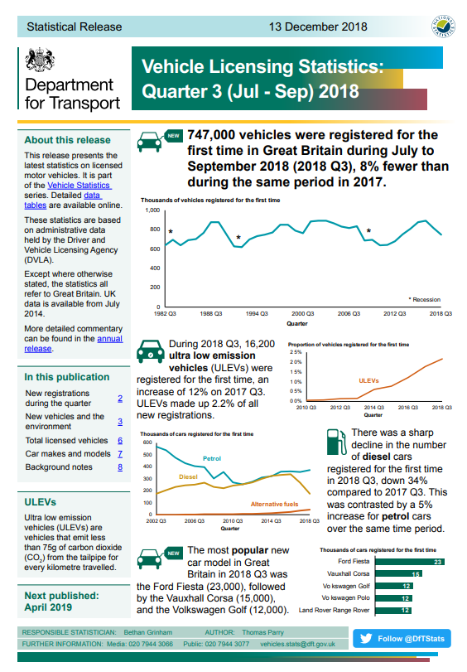
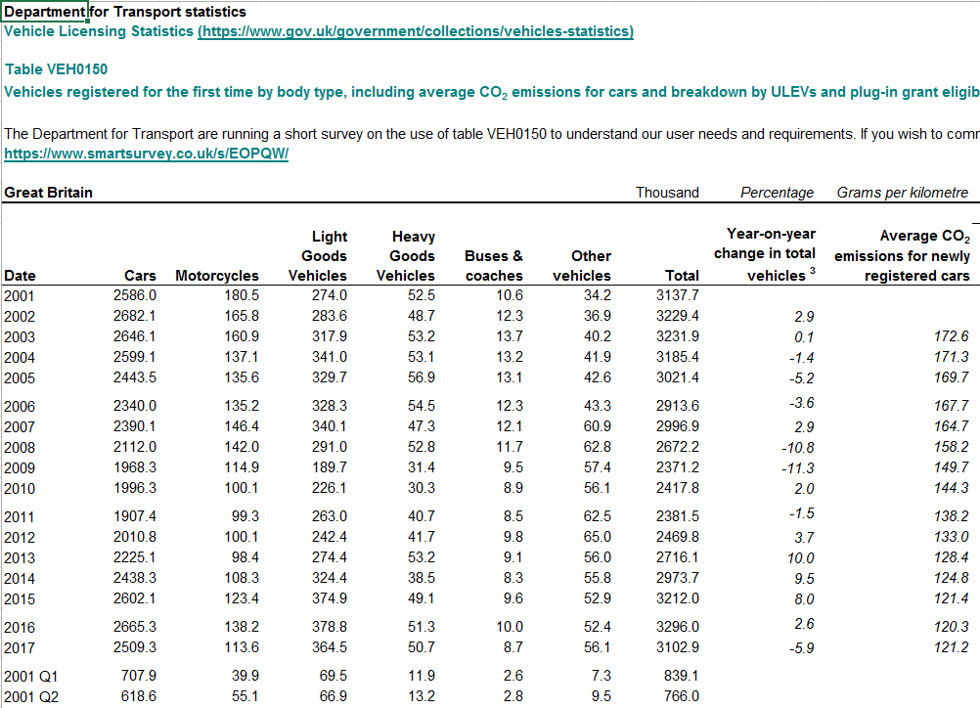
Vehicle Licensing Statistics

Slide 5
Vehicle Licensing Statistics
It’s chunky
76 tables due out for annual in April
19 tables for quarterly releases
Two heavily related but different data sources
New registrations
Vehicle stock
Quick stats
747,000 vehicles were registered for the first time in 2018 Q3 in GB
At the end of September 2018, there were 38.4 million licensed vehicles in Great Britain
Quick stats about the stats
The largest table we publish is VEH0220, licensed cars by make, model, fuel type and engine size:
54Mb
57 columns
circa 48k rows
8 versions in the file
GB licensed stock data tables refer to 1.9 billion vehicle records
GB SORN stock data tables refer to 110 million vehicle records
Notes:
VEH0220 – Cars by make, model, fuel type and engine size
One of the many potential benefits is using it to validate tables against other tables.

Slide 6
Current process
SQL scripts are updated manually and produce data via “select” statements
Data is pasted into Excel tables and tidied up by hand
Verified by a second person against total tables
Converted into ODS files
Focus on RAPing this
Let’s not go there…

Slide 7
Demo - SQL
Notes:
Go through VEH01 – 01, 20, 50
Why use stored procedure? Why not view?
VEH0101 has an IDS
VEH0120 uses SQL pivots, which provides a flexible number of columns

Slide 8
Demo - R

Slide 9
Upcoming Issues
Time!
Trying to apply a consistent approach to tables that are structured differently – do we change their structure?
How to present GB vs UK data
RAP gives us tables to spare (e.g. HGV by fuel type)
Current validation output is helpful for 1 table but not for 76!
How do we convey all these changes to users?

Slide 10
Questions? Suggestions?

